Slide 1

Microcontrollers
Er. साहित बराल July 7 / 2022

Slide 2
History of 8051 Microcontroller
The first microprocessor 4004 was invented by Intel Corporation.
8085 and 8086 microprocessors were also invented by Intel. In 1981, Intel introduced an 8-bit microcontroller called the 8051.
It was referred as system on a chip because it had 128 bytes of RAM, 4K byte of on-chip ROM, two timers, one serial port, and 4 ports (8-bit wide), all on a single chip.
When it became widely popular, Intel allowed other manufacturers to make and market different flavors of 8051 with its code compatible with 8051.
8051 microcontroller based on Harvard architecture
Several versions with different speeds and amounts of on-chip RAM.

Slide 3
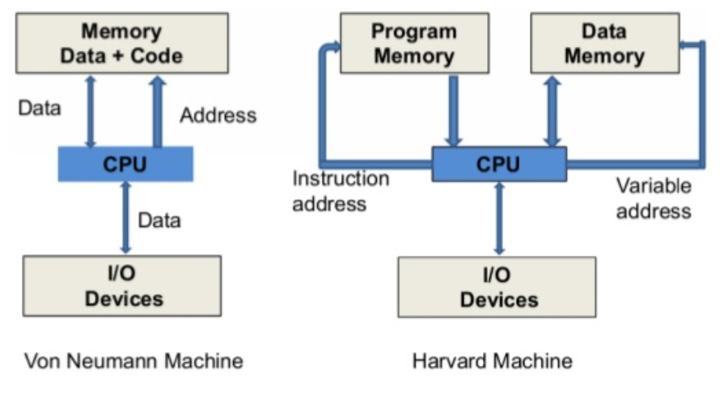
Processor Classification

Slide 4
1. Introduction
A microcontroller is a compact integrated circuit designed to govern a specific operation in an embedded system.
A typical microcontroller includes a processor, memory and input/output (I/O) peripherals on a single chip.
Embedded controller or microcontroller unit (MCU), microcontrollers are found in vehicles, robots, office machines, medical devices, mobile radio transceivers, vending machines and home appliances, among other devices.
They are essentially simple miniature personal computers (PCs) designed to control small features of a larger component, without a complex front-end operating system (OS).

Slide 5
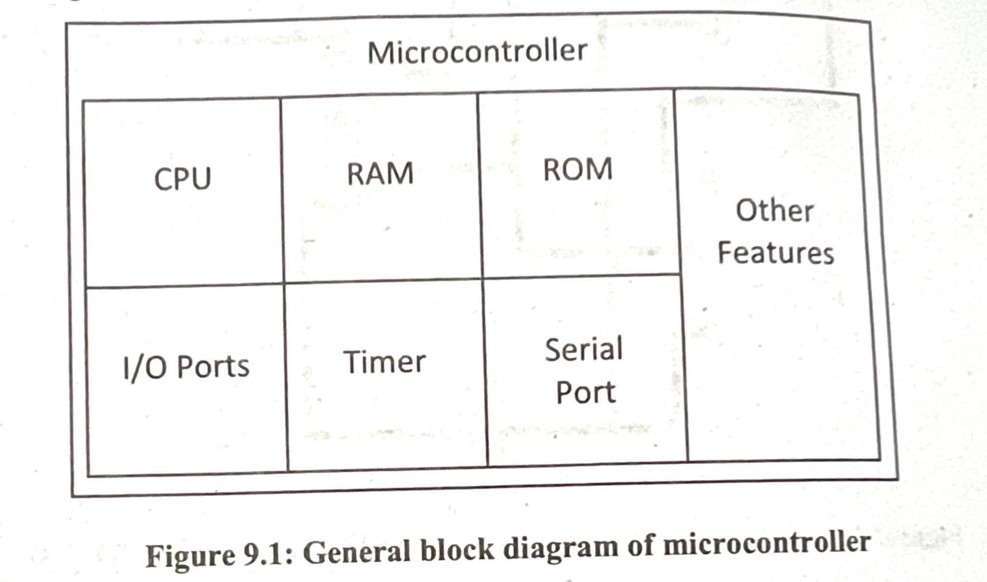
2. Block diagram
General block diagram of the microcontroller is shown in the figure below:

Slide 6
3. Comparison with microprocessor
SN | Microprocessor | Microcontroller
1 | General purpose processors | Special purpose processors
2 | contains complete functional In addition to functional CPU | In addition to functional CPU, it CPU only has timers, I/O ports, internal RAM and ROM, and other features
3 | Designer can select the size of memory, number of I/O ports, timers, etc to be used | Size of memory, number of I/O ports, internal RAM, ROM and other features
4 | Clock speed in very high in GHz range | Clock speed is low in MHZ range
5 | Powerful addressing modes and many instructions are available to move data between CPU and memory | It focuses on a bit handling instructions along with byte processing instructions
6 | Access time for external memory and I/O devices is more | Access time for on-chip memory and I/O devices is less
7 | Microprocessor based systems are expensive and consume more power | Microcontroller based systems are cheap and consumes less power

Slide 7
4. selecting/criteria for microprocessor
Meeting the computing needs of the task at hand efficiently and cost effectively, the different considerations are:
Speed- What is the highest speed?
Packaging
Power Consumption
The size of RAM and ROM on-chip (Data/Program sizes)
The number of I/O pins and the timers on the chip.
How easy it is to upgrade to higher performance/lower power consumptions?
Cost per unit- importance in terms of final cost of the product.

Slide 8
4. selecting/criteria for microprocessor
Availability of software development tools:
How easy it is to develop product around it?
Key considerations: availability of assemblers, debuggers, a code-efficient C language compilers, emulator, technical support and both in-house and outside expertise.
Wide availability and reliable sources of the microcontrollers: Easy availability in needed quantities both now and in the future.

Slide 9
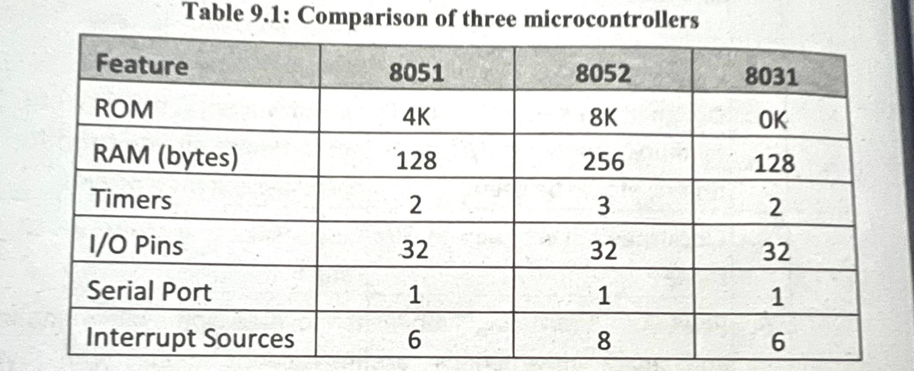
5. Comparison of 8051 Family member
Each member of 8051, somehow, differs from each other. Though the instruction sets are almost common, the features provided can vary.
The 8031 microcontroller is also referred as ROMless 8051 as all features are common except ROM space.
The following table shows comparison of 8051, 8052 and 8031 microcontrollers.

Slide 10
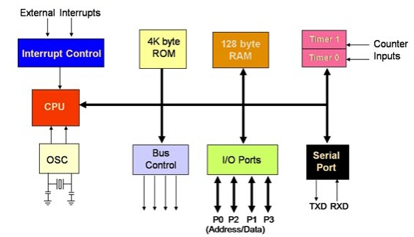
6. 8051 Architecture
i. Internal block diagram of 8051

Slide 11
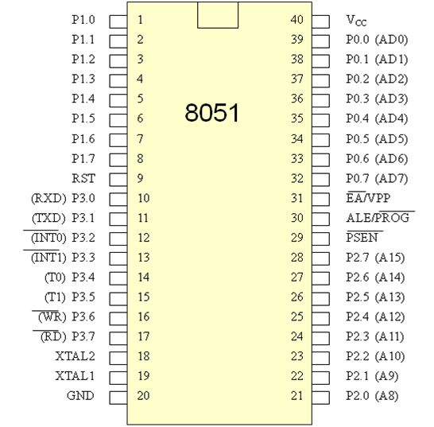
7 Pin Descriptions
40 pins
Four ports (32 pins)

Slide 12
Pin Diagram
Pin 32-39 PORT 0. Similar to P2, if external memory is not used, these pins can be used as general inputs/outputs. Otherwise, P0 is configured as address output (A0-A7) when the ALE pin is driven high (1) or as data output (Data Bus) when the ALE pin is driven low (0).
Pins 1-8: PORT 1. Each of these pins can be configured as an input or an output.
Pin 21-28 Port 2. If there is no intention to use external memory then these port pins are configured as general inputs/outputs. In case external memory is used, the higher address byte, i.e. addresses A8-A15 will appear on this port.

Slide 13
Pin Diagram
Pins10-17 PORT 3. Similar to port 1, each of these pins can serve as general input or output. Besides, all of them have alternative functions.
Pin 10 RXD. Serial asynchronous communication input or Serial synchronous communication output.
Pin 11 TXD. Serial asynchronous communication output or Serial synchronous communication clock output.
Pin 12 INT0. External Interrupt 0 input.
Pin 13 INT1. External Interrupt 1 input.
Pin 14 T0. Counter 0 clock input.
Pin 15 T1. Counter 1 clock input
Pin 16 WR. Write to external (additional) RAM.
Pin 17 RD. Read from external RAM

Slide 14
Pin Diagram
Pin 30 ALE(Address Latch enable). To demultiplex address bus and data bus
Pin 31 EA(Externally access). Access 128kb memory(external & internal)
Pin 29 PSEN(program strobe enable). If external ROM is used for storing program then a logic zero (0) appears on it every time the microcontroller reads a byte from memory.
Pin 40 VCC. +5V power supply.
Pin 20 GND. Ground.

Slide 15
Pin Diagram
Pin 18, 19 XTAL2, XTAL1. Internal oscillator input and output. A quartz crystal which specifies operating frequency is usually connected to these pins.
Pin 9 RESET. A logic one on this pin disables the microcontroller and clears the contents of most registers. In other words, the positive voltage on this pin resets the microcontroller. By applying logic zero to this pin, the program starts execution from the beginning.

Slide 16
Resister Classification - 8051
It is used to store information temporary
8-bit Accumulator B register 8 register bank R0-R3 Stack pointer | 16-bit Program counter Data pointer | SFR(Special Function Register) {Reserved} P0-P3 TMOD(Timer mode register) TCON(Timer control register) TH0-TL0(Timer register) PSW(Process states word)

Slide 17
Instruction Syntax.
LABEL
The label is a symbolic address for the instruction
When the program is assembled, the label will be given specific address in which that instruction is stored
Not necessary unless specific line has to be addressed
OPCODE
Opcode is the symbolic representation of the operation
The assembler converts the opcode to a unique binary code(machine language)

Slide 18
OPERAND
Operand field generally contains the source and destination of the data or data itself
Comment
Always comment will begin with ; or // symbol.
To improve the program quality, programmer may always use comments in the program
Eg. MOV A,B

Slide 19
Addressing Modes
Various methods of accessing the data are called address modes
8051 addressing modes are classified as follows
Immediate addressing
Register addressing
Direct addressing
Indirect addressing
Relative addressing
Absolute addressing
Long addressing
Indexed addressing
Bit inherent addressing
Bit direct addressing

Slide 20
Immediate addressing
Source operand is constant
Immediate data must be preceded by the sign, ‘#’
In this addressing mode the data is provided as a part of instruction itself. In other words data immediately follows the instruction.
This addressing mode can be used to load information into any of the register
Eg. MOV A, #83 // load the decimal value 83 into A
MOV A, #50H // load 50H into A
MOV DPTR, #1000H // load DPTR = 1000H

Slide 21
Direct addressing
There are 128 bytes of RAM in 8051
This mode most often used to access RAM location 30-7FH
In this addressing mode, data is obtained directly from the memory.
Eg. MOV A, 60H // save content of ram location 30H to A
ADD R0, 30H // add value of R0 and value is in 30H
MOV R6,R2 // invalid (not mention any RAM location)

Slide 22
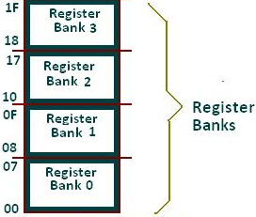
Register addressing
In this addressing mode the register will hold the data. One of the eight general registers (R0 to R7) can be used and specified as the operand.
Eg. MOV A, R0
ADD A, R6
R0 – R7 will be selected from the current selection of register bank. The default register bank will be bank 0.

Slide 23
Register Indirect addressing
The indirect addressing mode uses a register to hold the actual address that will be used in data movement.
Registers R0 and R1 and DPTR are the only registers that can be used as data pointers.
Indirect addressing cannot be used to refer to SFR registers.
Both R0 and R1 can hold 8 bit address and DPTR can hold 16 bit address.
Eg. MOV A,@R0
ADD A,@R1
MOV A,@DPTR

Slide 24
Index addressing
This addressing mode is used to access data from code memory(Internal ROM and External ROM)
In indexed addressing, either the program counter (PC), or the data pointer (DTPR)—is used to hold the base address, and the A is used to hold the offset address.
Indexed addressing is used with JMP or MOVC (mov code)instructions.
Eg.
- MOVC A, @A+DPTR // copies the contents of memory location pointed by the sum of the accumulator A and the DPTR into accumulator A.
- MOVC A, @A+PC // copies the contents of memory location pointed by the sum of the accumulator A and the program counter into accumulator A.

Slide 25
Relative addressing
Relative addressing is used only with conditional jump instructions
The relative address, (offset), is an 8 bit signed number, which is automatically added to the PC to make the address of the next instruction
Effective address = PC + offset
Eg. SJMP LOOP1
JC BACK
500
501
502
.
.
.
.
.
549
550
JMP 550

Slide 26
Absolute addressing
Absolute addressing is used only by the AJMP (Absolute Jump) and ACALL (Absolute Call) instructions.
These are 2 bytes instructions. - The absolute addressing mode specifies the lowest 11 bit of the memory address as part of the instruction. - The upper 5 bit of the destination address are the upper 5 bit of the current program counter.
Hence, absolute addressing allows branching only within the current 2 Kbyte page of the program memory. Eg. AJMP LOOP1 ACALL LOOP2

Slide 27
Long addressing
The long addressing mode is used with the instructions LJMP and LCALL.
These are 3 byte instructions.
The address specifies a full 16 bit destination address so that a jump or a call can be made to a location within a 64 Kbyte code memory space.
Eg. LJMP FINISH
LCALL DELAY

Slide 28
Bit inherent addressing
In this addressing, the address of the flag which contains the operand, is implied in the opcode of the instruction.
Eg. CLR C; Clears the carry flag to 0

Slide 29
Bit direct addressing
In this addressing mode the direct address of the bit is specified in the instruction.
The RAM space 20H to 2FH and most of the special function registers are bit addressable.
Bit address values are between 00H to 7FH.
Eg. CLR 07h; Clears the bit 7 of 20h RAM space
SETB 07H; Sets the bit 7 of 20H RAM space.

Slide 31
8051 Instructions
Instructions is a command which we give to the microcontroller to perform any task
Entire group of instruction is called instruction set. And a set of instruction is called program
Instructions written in a program tell the microcontroller which operation to carry out
Syntax Opcode Destination, Source MOV R1,R2

Slide 32
8051 Instructions
8051 microcontroller 8-bit processor, the Microcontroller instruction have 8-bit opcodes
As a result, the Microcontroller instruction set can have up to 2^8 = 256 instructions

Slide 33
Data transfer instructions
The instructions of 8051 can be broadly classified under the following headings.
Data transfer instructions
Arithmetic instructions
Logical instructions
Branch instructions
Subroutine instructions
Bit manipulation instructions

Slide 34
Data transfer instructions
Only move data from one location to another location
Do not perform any operation like addition, subtraction etc
Do not modify data
Syntax Opcode Destination, Source

Slide 35
Data transfer instructions
3 Types of Data transfer Instruction are:
MOV
PUSH or POP
XCHG

Slide 36
Data transfer instructions
1. MOV instruction
In this instruction, move or copy the content from the source location to destination location.
Syntax: MOV Destination, Source
Move the contents of a register Rn to A
MOV A,R2
MOV A,R7
Move the contents of a register A to Rn
MOV R4,A
MOV R1,A

Slide 37
Data transfer instructions
Move an immediate 8 bit data to register A or to Rn or to a memory location(direct or indirect)
MOV A, #45H iv. MOV @R0, #0E8H
MOV R6, #51H v. MOV DPTR, #0F5A2H
MOV 30H, #44H vi. MOV DPTR, #5467H
Move the contents of a memory location to A or A to a memory location using direct and indirect addressing
MOV A, 65H iii. MOV 45H, A
MOV A, @R0 iv. MOV @R1, A
Move the contents of a memory location to Rn or Rn to a memory location using direct addressing
i. MOV R3, 65H ii. MOV 45H, R2

Slide 38
Data transfer instructions
Move the contents of memory location to another memory location using direct and indirect addressing
MOV 47H, 65H ii. MOV 45H, @R0
Move the contents of an external memory to A or A to an external memory (external ROM)
i. MOVX A,@R1 iii. MOVX A, @DPTR
MOVX @R0,A iv. MOVX @DPTR, A
Move the contents of program memory to A (internal ROM)
i. MOVC A, @A+PC
ii. MOVC A, @A+DPTR
Notes:
MOVC instruction is responsible for moving data from the Program memory (Flash memory) to the RAM for processing it.
The 8051 microcontroller in most cases has an on-chip 4K flash memory, but due to its 16-bit address bus, it can access 64k memory locations. Due to this reason, the 8051 can be interfaced with external memory using ports 0 and 2. To access data in this external memory, the MOVX instruction is used

Slide 39
Data transfer instructions
2) PUSH 2 POP Instruction
This two instructions are stack related instructions
Example :
PUSH direct //push into stack
POP direct //pop from the stack
3) Exchange (XCHG) Instruction
Exchange accumulator and a byte variable
Example:
XCHG A, Rn;
XCHG A, 54H;

Slide 40
Q1) Write a program to move value 50H and store the result in Accumulator
answer
ORG 0000H ; Set program counter 0000H
MOV A, #50H ; Move value from 52H to 50H

Slide 41
Q2) Write a program move value from location 50H and store the result in locations in 52H
answer
ORG 0000H ; Set program counter 0000H
MOV 52H, 50H ; Move value from 50H to 52H

Slide 42
Q3) Write a program to move a value address from location 50H and store the result in Register R2
answer
ORG 0000H ; Set program counter 0000H
MOV R2, @50H ; Move value from @50h to R2

Slide 43
Q4) Write a program to exchange the value of Accumulator and address hold by location 23H
answer
ORG 0000H ; Set program counter 0000H
XCHG A, @23H ; Exchange the value between accumulator and @23H

Slide 44
Arithmetic Instructions
This group of operations perform arithmetic operations(like addition, subtraction etc)
Arithmetic operation effect the flags, such as Carry Flag(CY), Overflow Flag(OV), etc, in the PSW register
Type of arithmetic instructions
ADD (addition Instruction)
SUB (Subtraction Instruction)
DIV (Division Instruction)
MUL (Multiplication Instruction)
INC( Increment Instruction)
DEC (Decrement Instruction)

Slide 45
Arithmetic Instructions
Addition
Add the contents of A with immediate data with or without carry.
ADD A, #45H
ADDC A, #OB4H
Add the contents of A with register Rn with or without carry.
ADD A, R5
ADDC A, R2
Add the contents of A with contents of memory with or without carry using direct and indirect addressing
ADD A, 51H ii. ADDC A, 75H
iii. ADD A, @R1 iv. ADDC A, @R0

Slide 46
Arithmetic Instructions
Subtraction
Subtract the contents of A with immediate data with or without borrow.
SUB A, #45H ii. SUBB A, #OB4H
Subtract the contents of A with register Rn with or without borrow.
SUB A, R5 ii. SUBB A, R2
Subtract the contents of A with contents of memory with or without carry using direct and indirect addressing
SUB A, 51H ii. SUBB A, 75H
iii. SUB A, @R1 iv. SUBB A, @R0

Slide 47
Arithmetic Instructions
Multiplication
MUL AB. This instruction multiplies two 8 bit unsigned numbers which are stored in A and B register. After multiplication the lower byte of the result will be stored in accumulator and higher byte of result will be stored in B register.
Eg.
MOV A,#45H ;[A]=45H
MOV B,#0F5H ;[B]=F5H
MUL AB ;[A] x [B] = 45 x F5 = 4209
;[A] = 09H, [B] = 42H

Slide 48
Arithmetic Instructions
Division
DIV AB. This instruction divides the 8 bit unsigned number which is stored in A by the 8 bit unsigned number which is stored in B register. After division the result will be stored in accumulator and remainder will be stored in B register.
Eg.
MOV A,#45H ;[A]=45H
MOV B,#06H ;[B]=06H
DIV AB ;[A] / [B] = 45 / 6 = 07 H with remainder 03H
;[A] = 07H, [B]=03H

Slide 49
Arithmetic Instructions
Increment: increments the operand by one.
INC A
INC increments the value of source by 1. If the initial value of register is FFh, incrementing the value will cause it to reset to 0.
Decrement: decrements the operand by one.
DEC A
DEC decrements the value of source by 1. If the initial value of is 0, decrementing the value will cause it to reset to FFh.

Slide 50
Q) Write a program to add the values of locations 50H and 51H and store the result in locations in 52H
answer:
ORG 0000H ; Set program counter 0000H
MOV A,50H ; Load the contents of Memory location 50H into A
ADD A,51H ; Add the contents of memory 51H with A
MOV 52H,A ; Save the result in 52H
END

Slide 51
Q) Write a program to store data FFH into RAM memory locations 50H to 58H using direct addressing mode
answer:
ORG 0000H ; Set program counter 0000H
MOV A, #0FFH ; Load FFH into A
MOV 50H, A ; Store contents of A in location 50H
MOV 51H, A ; Store contents of A in location 5IH
MOV 52H, A ; Store contents of A in location 52H
MOV 53H, A ; Store contents of A in location 53H
MOV 54H, A ; Store contents of A in location 54H
MOV 55H, A ; Store contents of A in location 55H
MOV 56H, A ; Store contents of A in location 56H
MOV 57H, A ; Store contents of A in location 57H
MOV 58H, A ; Store contents of A in location 58H
END

Slide 52
Logical Instructions
In 8051 Microcontroller there is 25 different instructions under the Logical Group. In total there are 49 opcodes. The Carry Flag(CY) affects only by instructions RRC and RLC.
Logical operations in 8051 perform bitwise operations between the accumulator and data stored in a memory location, register, or data given by the programmer
The result of a logical operations is stored in the accumulator

Slide 53
Logical Instructions
Type of Logical operations
AND operation
OR operation
XOR operation
NOR operation
NOT operation
CLR operation
Complement operation
SWAP operation
Rotate operation

Slide 54
Logical Instructions
Logical AND
ANL destination, source: ANL does a bitwise "AND" operation between source and destination, leaving the resulting value in destination. The value in source is not affected. "AND" instruction logically AND the bits of source and destination.
ANL A,#DATA
ANL A, Rn

Slide 55
Logical Instructions
Logical OR
ORL destination, source: ORL does a bitwise "OR" operation between source and destination, leaving the resulting value in destination. The value in source is not affected. " OR " instruction logically OR the bits of source and destination.
ORL A,#DATA
ORL A, Rn

Slide 56
Logical Instructions
Logical Ex-OR
XRL destination, source: XRL does a bitwise "EX-OR" operation between source and destination, leaving the resulting value in destination. The value in source is not affected. " XRL " instruction logically EX-OR the bits of source and destination.
XRL A,#DATA
XRL A,Rn

Slide 57
Logical Instructions
Logical NOT
CPL complements operand, leaving the result in operand. If operand is a single bit then the state of the bit will be reversed. If operand is the Accumulator then all the bits in the Accumulator will be reversed.
CPL A, CPL C, CPL bit address

Slide 58
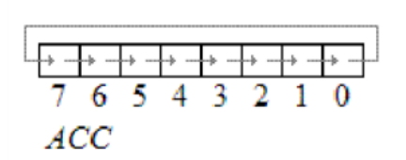
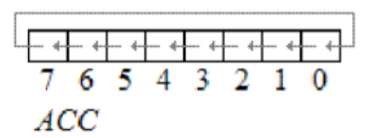
Logical Instructions
Rotate Instructions
RR A
This instruction is rotate right the accumulator. Its operation is illustrated below. Each bit is shifted one location to the right, with bit 0 going to bit 7.
RL A
Rotate left the accumulator. Each bit is shifted one location to the left, with bit 7 going to bit 0

Slide 59


Logical Instructions
RRC A
A Rotate right through the carry. Each bit is shifted one location to the right, with bit 0 going into the carry bit in the PSW, while the carry was at goes into bit 7
RLC A
Rotate left through the carry. Each bit is shifted one location to the left, with bit 7 going into the carry bit in the PSW, while the carry goes into bit 0.

Slide 60
Branch Instructions
The branch group of instructions are generally used to change the sequence of the program execution
There are two type of branch instruction
Conditional
Unconditional
Conditional branch instruction transfer the program to the specified address only when the condition is satisfied
The unconditional branch instructions transfer the program to the specified address unconditionally
Example: JUMP, CALL, RETURN

Slide 61
Branch Instructions
JUMP Instructions CALL and RETURN Instructions

Slide 62
JUMP Instructions
Unconditional JUMP
Long JUMP (LJMP)
LJMP causes an unconditional branch to indicated address, by loading PC with 16 bit address.
The destination address will be any where in the full 64k program memory address space
PC Addr 16 Example : LJMP 4200 [PC] 4200

Slide 63
JUMP Instructions
Unconditional JUMP
Absolute JUMP (AJMP)
AJMP causes an unconditional branch to indicated address, by loading 11 bit address to 0 to 10 bits of the PC.
The destination address must be within the same 2K blocks
Example : AJMP 204 [PC 10-0] 204

Slide 64
JUMP Instructions
Unconditional JUMP
Short JUMP (SJMP)
Instruction enables jump to the new address which should be in the range of -128 to +127 locations relative to the first following instruction.
SJMP 25
Example : [PC] [PC]+25;
JMP Indirect
The contents of an A is added with 16 bit content of DPTR and 16 bit is loaded to PC
JMP @A+DPTR (Jump indirect relative to DPTR)
[PC] [A]+[DPTR] ; If DPTR = 8000H and A= 04H then PC = 8004H

Slide 65
JUMP Instructions
Conditional JUMP
JUMP If carry (JC), relative address(displacement)
If the carry is set branch to address indicated; otherwise execute next the instruction
[PC] [PC]+2
IF [CY]=1 then [PC] [PC]+DISPLACEMENT
JUMP if not carry(JNC), rel
If the carry is not set branch to address indicated; otherwise execute next the instruction
[PC] [PC]+2
IF [CY]=0 then [PC] [PC]+DISPLACEMENT

Slide 66
JUMP Instructions
Conditional JUMP
JUMP If accumulator is zero (JZ), relative address(displacement)
If all the bits of accumulator are zero, jump to next address; otherwise execute next the instruction
[PC] [PC]+2
IF [A]=0 then [PC] [PC]+DISPLACEMENT
JUMP If accumulator is not zero (JNZ), relative address(displacement)
If any bit of accumulator is “1”, jump to next address; otherwise execute next the instruction
[PC] [PC]+2
IF [A]!=0 then [PC] [PC]+ rel(DISPLACEMENT)

Slide 67
JUMP Instructions
DRCREMENT & JUMP IF NOT ZERO
Decrement register and jump if not zero(DJNZ), relative address(displacement)
Decrement the content of register Rn by 1 and jump to the address indicated if resulting value is not zero example: DJNZ Rn, rel[displacement]
[PC] [PC] + 2
[Rn] [Rn]-1
If [Rn]!=0 then [PC] [PC]+displacement

Slide 68
JUMP Instructions
COMPARE & JUMP IF NOT EQUAL (CJNE)
CJNE compare the magnitude of the first two operand and branches if their values are not equal
CJNE A, direct, rel (Compare direct byte to ACC, jump if not equal)
[PC] [PC] + 3; If A != direct, then PC PC + rel
Example - CJNE A, 35, 05 [A] != m[35], [PC] [PC] + 3 +05
Notes:
3 byte instructions

Slide 69
JUMP Instructions
COMPARE & JUMP IF NOT EQUAL (CJNE)
CJNE A, #data, rel (Compare direct byte to ACC, jump if not equal)
[PC] [PC] + 3; If A != direct, then PC PC + rel
Example - CJNE A, #45, 50 [A] != 45 then [PC] [PC] + 3 +50
Notes:
3 byte instructions

Slide 70
JUMP Instructions
COMPARE & JUMP IF NOT EQUAL (CJNE)
CJNE @Ri, #data, rel (Compare indirect to immediate, jump if not equal)
[PC] [PC] + 3;
If Ri != #data, then PC PC + rel
Example - CJNE @R0, #45, 50 IF M[R0] != 45 then [PC] [PC] + 3 +50
Notes:
3 byte instructions

Slide 71
Subroutine call and Return Instructions
LCALL address (16 bit)
This is long call instruction which unconditionally calls the subroutine located at the indicated 16 bit address. This is a 3 byte instruction. The LCALL instruction works as follows.
a. During execution of LCALL, [PC] = [PC]+3; (if address where LCALL resides is say, 0x3254; during execution of this instruction [PC] = 3254h + 3h = 3257h
b. [SP]=[SP]+1; (if SP contains default value 07, then SP increments and [SP]=08
c. [SP] = [PC7-0]; (lower byte of PC content ie., 57 will be stored in memory location 08.
d. [SP]=[SP]+1; (SP increments again and [SP]=09)
e. [SP] = [PC15-8]; (higher byte of PC content ie., 32 will be stored in memory location 09. With these the address (0x3254) which was in PC is stored in stack.
f. [PC]= address (16 bit); the new address of subroutine is loaded to PC. No flags are affected.

Slide 72
Subroutine call and Return Instructions
ACALL address (11 bit)
This is absolute call instruction which unconditionally calls the subroutine located at the indicated 11 bit address. This is a 2 byte instruction. The ACALL instruction works as follows.
a. During execution of ACALL, [PC] = [PC]+2; (if address where ACALL resides is say, 0x8549; during execution of this instruction [PC] = 8549h + 2h = 854Bh
b. [SP]=[SP]+1; (if SP contains default value 07, then SP increments and [SP]=08
c. [[SP]] = [PC7-0]; (lower byte of PC content ie., 4B will be stored in memory location 08.
d. [SP]=[SP]+1; (SP increments again and [SP]=09)
e. [[SP]] = [PC15-8]; (higher byte of PC content ie., 85 will be stored in memory location 09. With these the address (0x854B) which was in PC is stored in stack.
f. [PC10-0]= address (11 bit); the new address of subroutine is loaded to PC. No flags are affected.

Slide 73
RET instructions
RET instruction pops top two contents from the stack and load it to PC.
g. [PC15-8] = [SP] ;content of current top of the stack will be moved to higher byte of PC.
h. [SP]=[SP]-1 ; (SP decrements)
i. [PC7-0] = [SP] ;content of bottom of the stack will be moved to lower byte of PC.
j. [SP]=[SP]-1 ; (SP decrements again)
RET1(Return from interrupt)
RET instruction pops top two contents from the stack and load it to PC.
It restores the interrupt logic at same priority level to accept the request from I/O devices

Slide 74
Questions
Q. Write a program to clear 20 RAM locations starting at RAM address 80H.
CLR A ; the content in ACC is used to clear RAM locations
MOV R1, #80H ; R1 is a pointer starting from 80H
MOV R7, #20 ; 20 iterations
Again: MOV @R1, A ; loop
INC R1
DJNZ R7, Again

Slide 75
Questions
Q. Write a program to add two 16-bit numbers. The numbers are 3CE7H and 3B8DH. Place the sum in R7 (high byte) and R6 (low byte).
CLR C
MOV A, #0E7H
ADD A, #8DH
MOV R6, A ; low byte
MOV A, #3CH
ADDC A, #3BH
MOV R7, A ; high byte

Slide 76
Questions
Q. Write a program to store data FFH into RAM memory locations 50H to 58H using indirect addressing mode.
Solutions:
ORG 0000H ; Set program counter 0000H
MOV A, #0FFH ; Load FFH into A
MOV R0, #50H ; Load pointer, R0=50H
MOV R5, #08H ; Load counter, R5=08H
Start: MOV @R0, A ; Copy contents of A to RAM pointed by R0
INC R0 ; Increment pointer
DJNZ R5, start ; Repeat until R5 is zero
END

Slide 78
Assembler Directives
Assembler directives tell the assembler to do something other than creating the machine code for an instruction.
In assembly language programming, the assembler directives instruct the assembler to
Process subsequent assembly language instructions
Define program constants
Reserve space for variables
The following are the widely used 8051 assembler directives.
Widely used 8051 assembler directives:- ORG(origin), EQU & SET, DB(define byte), END

Slide 79
Assembler Directives
ORG(Origin)
The ORG directive is used to indicate the starting address.
It can be used only when the program counter needs to be changed.
The number that comes after ORG can be either in hex or in decimal.
Eg: ORG 0000H ;Set PC to 0000.

Slide 80
Assembler Directives
EQU and SET
EQU and SET directives assign numerical value or register name to the specified symbol name
EQU is used to define a constant without storing information in the memory. The symbol defined with EQU should not be redefined.
SET directive allows redefinition of symbols at a later stage.

Slide 81
Assembler Directives
DB (Define Byte)
The DB directive is used to define an 8 bit data. DB directive initializes memory with 8 bit values.
The numbers can be in decimal, binary, hex or in ASCII formats.
For decimal, the 'D' after the decimal number is optional, but for binary and hexadecimal, 'B' and ‘H’ are required.
For ASCII, the number is written in quotation marks (‘LIKE This).
DATA1: DB 40H ; hex DATA2: DB 01011100B ; binary DATA3: DB 48 ; decimal DATA4: DB 'HELLOW’ ; ASCII

Slide 82
Assembler Directives
END
The END directive signals the end of the assembly module.
It indicates the end of the program to the assembler.
Any text in the assembly file that appears after the END directive is ignored.
If the END statement is missing, the assembler will generate an error message.

Slide 83
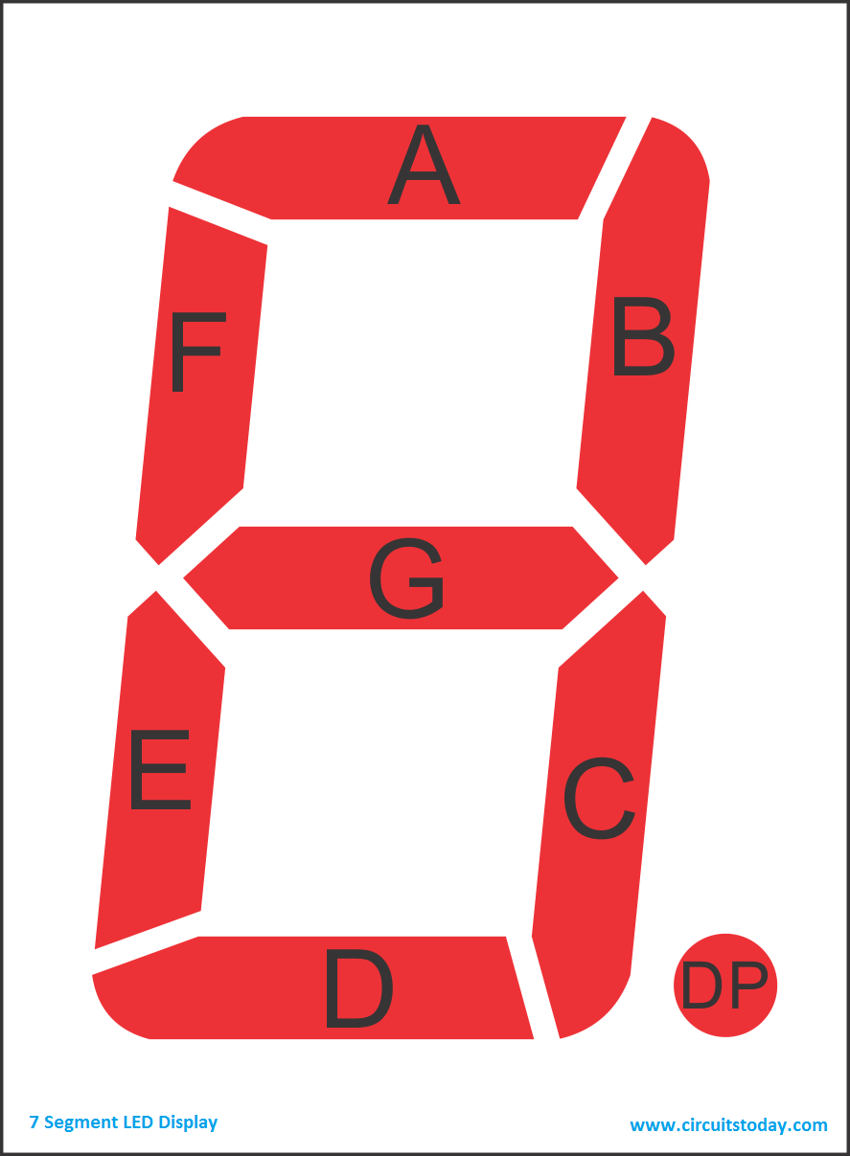
Interfacing SEVEN-SEGMENT Display
Seven segment displays are used to indicate numerical information.
Seven segments display can display digits from 0 to 9 and even we can display few characters like A, b, C, H, E, e, F, etc.
There is also a decimal point or dp. It is used when decimal digits like 5.1 etc are displayed.
Types of Seven-Segment display - Common Cathode 7-Segment Display - Common Anode 7-Segment Display

Slide 84


Interfacing SEVEN-SEGMENT Display
Common Cathode 7-Segment Display
In this type of segments all the cathode terminals are made common and tied to GND. Thus the segments a to g needs a logic High signal(5v) in order to glow.
Common Anode 7-Segment Display
In this type of segments all the anodes terminals are made common and tied to VCC(5v). Thus the segments a to g needs a logic LOW signal(GND) in order to glow.

Slide 85
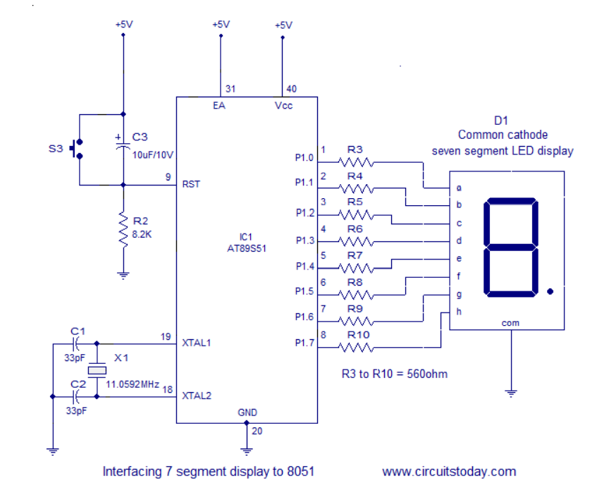
Interfacing SEVEN-SEGMENT Display

Slide 86
Interfacing SEVEN-SEGMENT Display

Slide 87
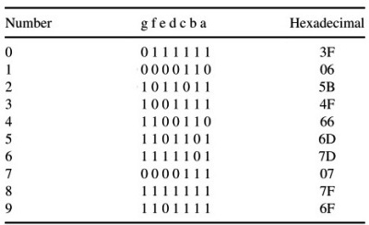
Interfacing SEVEN-SEGMENT Display
Common cathode

Slide 88
Interfacing SEVEN-SEGMENT Display
#Assembly program to display 0 to 9(cathode)(hex value)
MOV A, #00H
MOV P2, A ; make P2 as output port
MOV P2, #03FH
ACALL DELAY
MOV P2, #006H
ACALL DELAY
MOV P2, #05BH
ACALL DELAY
MOV P2, #04FH
ACALL DELAY
MOV P2, #066H
ACALL DELAY
MOV P2, #06DH
ACALL DELAY
MOV P2, #07DH
ACALL DELAY
MOV P2, #007H
ACALL DELAY
MOV P2, #07FH
ACALL DELAY
MOV P2, #06FH
ACALL DELAY

Slide 89
Interfacing SEVEN-SEGMENT Display
#C-program program to display 0 to 9(cathode)(hex value)
#include<reg51h>
Void delay(unsigned int);
Void main()
{
P2 = 0x00 ; // make P2 as output
}
P2 = 0x03F;
delay(200);
P2 = 0x006;
delay(200);
P2 = 0x05B;
delay(200);
P2 = 0x04F;
delay(200);
P2 = 0x066;
delay(200);
P2 = 0x06D;
delay(200);
P2 = 0x07D;
delay(200);
P2 = 0x007;
delay(200);
P2 = 0x07F;
delay(200);
P2 = 0x06F;
delay(200);
Void (delay)
{
unsigned int I,j;
for(i=0;i<n;i++)
for(j=0;j<1275;j++)
}

Slide 90
IMP Questions
Q. Tabulate 10 byte of data from data RAM locations 45H to 54H, add 02 to each of them, and save the result in data RAM address 79H down to 70H.
Answer: MOV R2, #10 ; R2 used as a counter MOV R0, #45H ; R0 points to first source location MOV R1, #79H ; R1 points to first source location BACK: MOV A, @R0 ; move source byte to A ADD A, #02 ; add 2 to it MOV @R1,A ; move it to destination INC R0 ; increment the source pointer DEC R1 ; decrement the pointer DJNZ R2, BACK ; repeat until counter = 0

Slide 91
Q. The word "SAM" is to be burned in the flash ROM location starting from 0400H of an AT89C51. Write a program to do this and read this data into internal RAM locations starting from 60H.
ORG 0000H ; program starts at location 0000H
CLR A ; A=0
MOV DPTR, #0400H ; DPTR = 400H (points to first source location)
MOVC A, @A+DPTR ; get 'S' from location 400H
MOV 60H, A ; move it to RAM location 60H
INC DPTR ; DPTR = 401H (points to next location)
CLR A ; A=0
MOVC A, @A+DPTR ; get 'A' from location 401H
MOV 61H, A ; move it to RAM location 61H
INC DPTR ; DPTR = 402H
CLR A ; A=0
MOVC A, @A+DPTR ; get 'M' from location 401H
MOV 62H, A ; move it to RAM location 62H
HERE: SJMP HERE ; stay here
ORG 400H
DB "SAM" ; data is burned into location starting from 400H
END ; directive for end of file

Slide 92
Q. Assuming that ROM space starting at 250H contains "Nepal”, write a program to transfer the bytes into RAM locations starting at 40H.
Answer: This method uses a counter
ORG 0000H
MOV DPTR, #0250H ; load ROM pointer
MOV RO, #40H ; load RAM pointer
MOV R2, #5 ; load counter
BACK: CLR A ;A=0
MOVC A, @A+DPTR ; move data from code space
MOV @RO, A ; save it in RAM
INC DPTR ; increment ROM pointer
INC RO ; increment RAM pointer
DJNZ R2, BACK ; loop until counter = 0
END

Slide 93
Q. Assuming that ROM space starting at 250H contains “America”, write a program to transfer the bytes into RAM locations starting at 40H.
Answer: This method uses a counter
ORG 0000
MOV DPTR, #0250H ; load ROM pointer
MOV RO, #40H ; load RAM pointer
MOV R2, #7 ; load counter
BACK: CLR A ;A=0
MOVC A, @A+DPTR ; move data from code space
MOV @RO, A ; save it in RAM
INC DPTR ; increment ROM pointer
INC RO ; increment RAM pointer
DJNZ R2, BACK ; loop until counter = 0
END

Slide 94
Applications of Microcontrollers
Microcontrollers are widely used in various different devices such as −
Light sensing and controlling devices like LED.
Temperature sensing and controlling devices like microwave oven, chimneys.
Fire detection and safety devices like Fire alarm.
Measuring devices like Volt Meter.

Slide 95
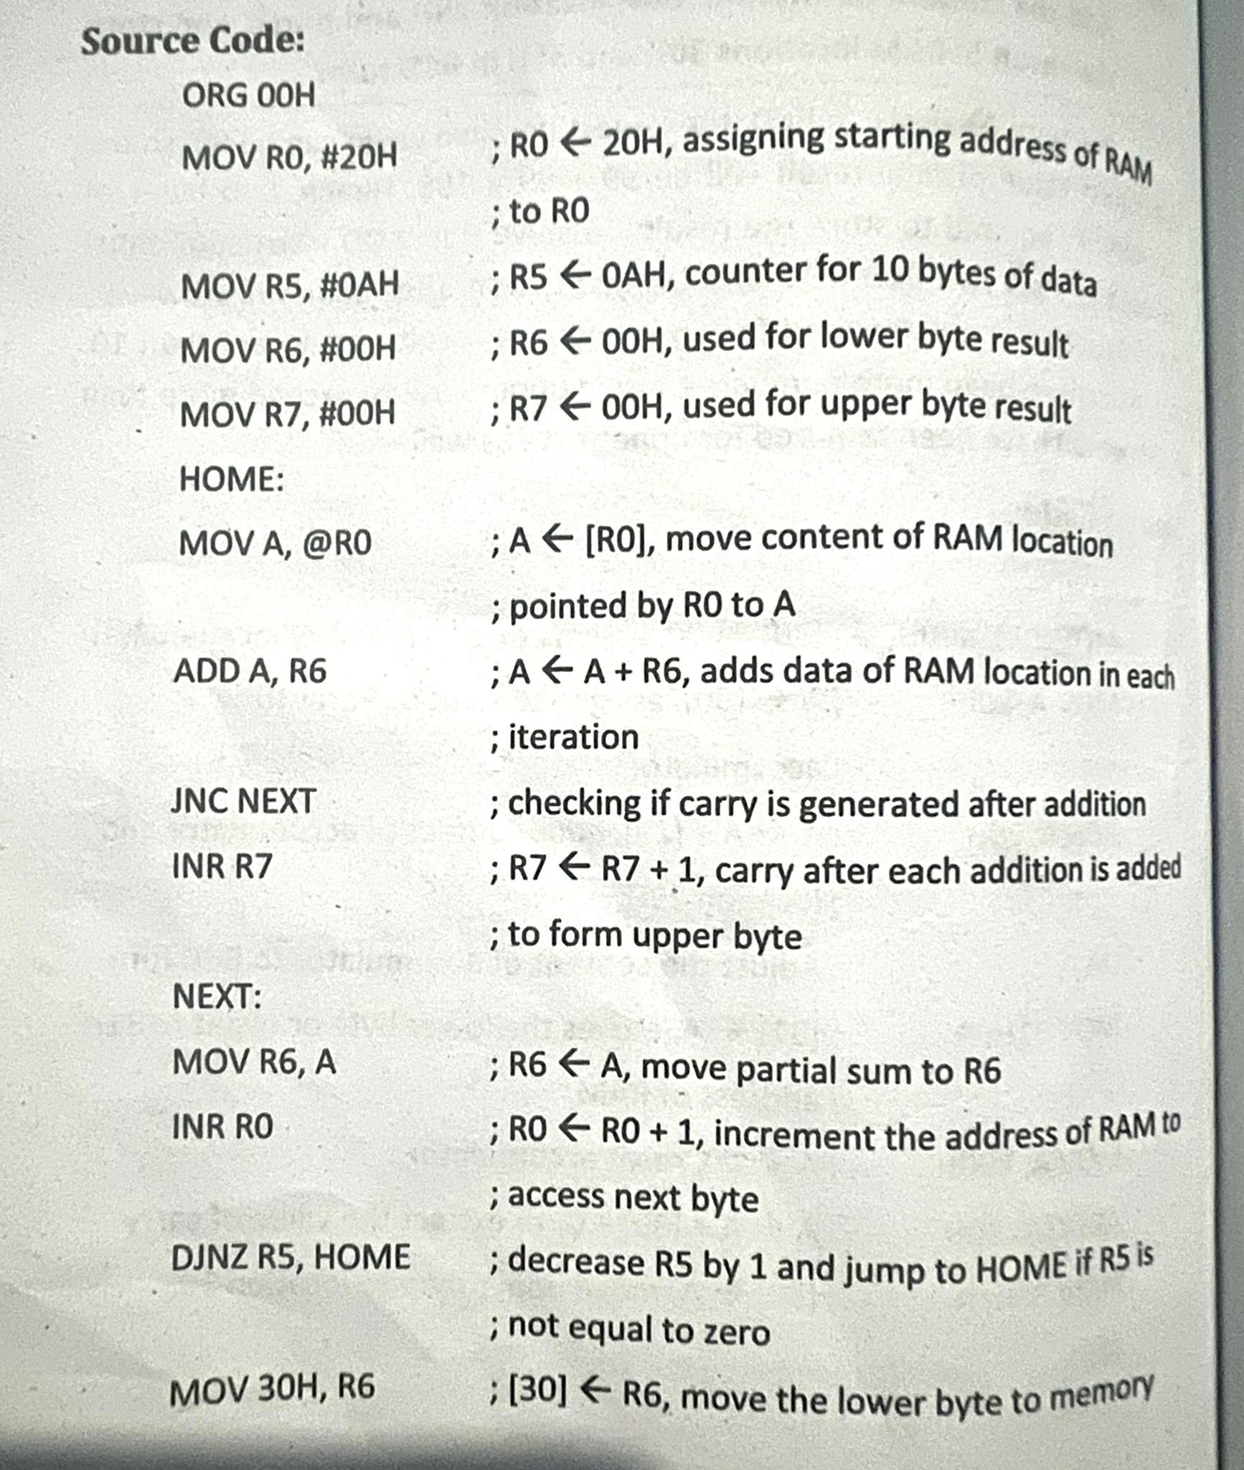
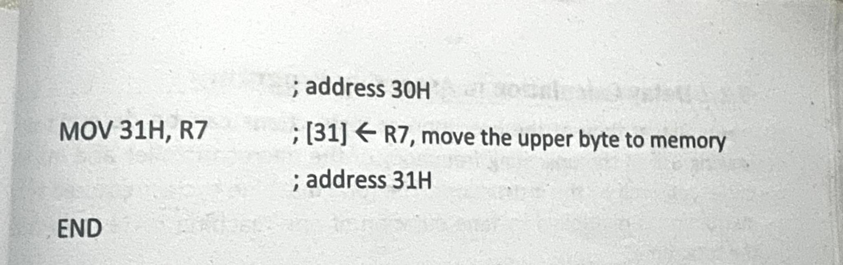
Q) Add 10 bytes of data of RAM location starting from address 20H. Store lower byte at 30H and upper byte at 31H.

Slide 96
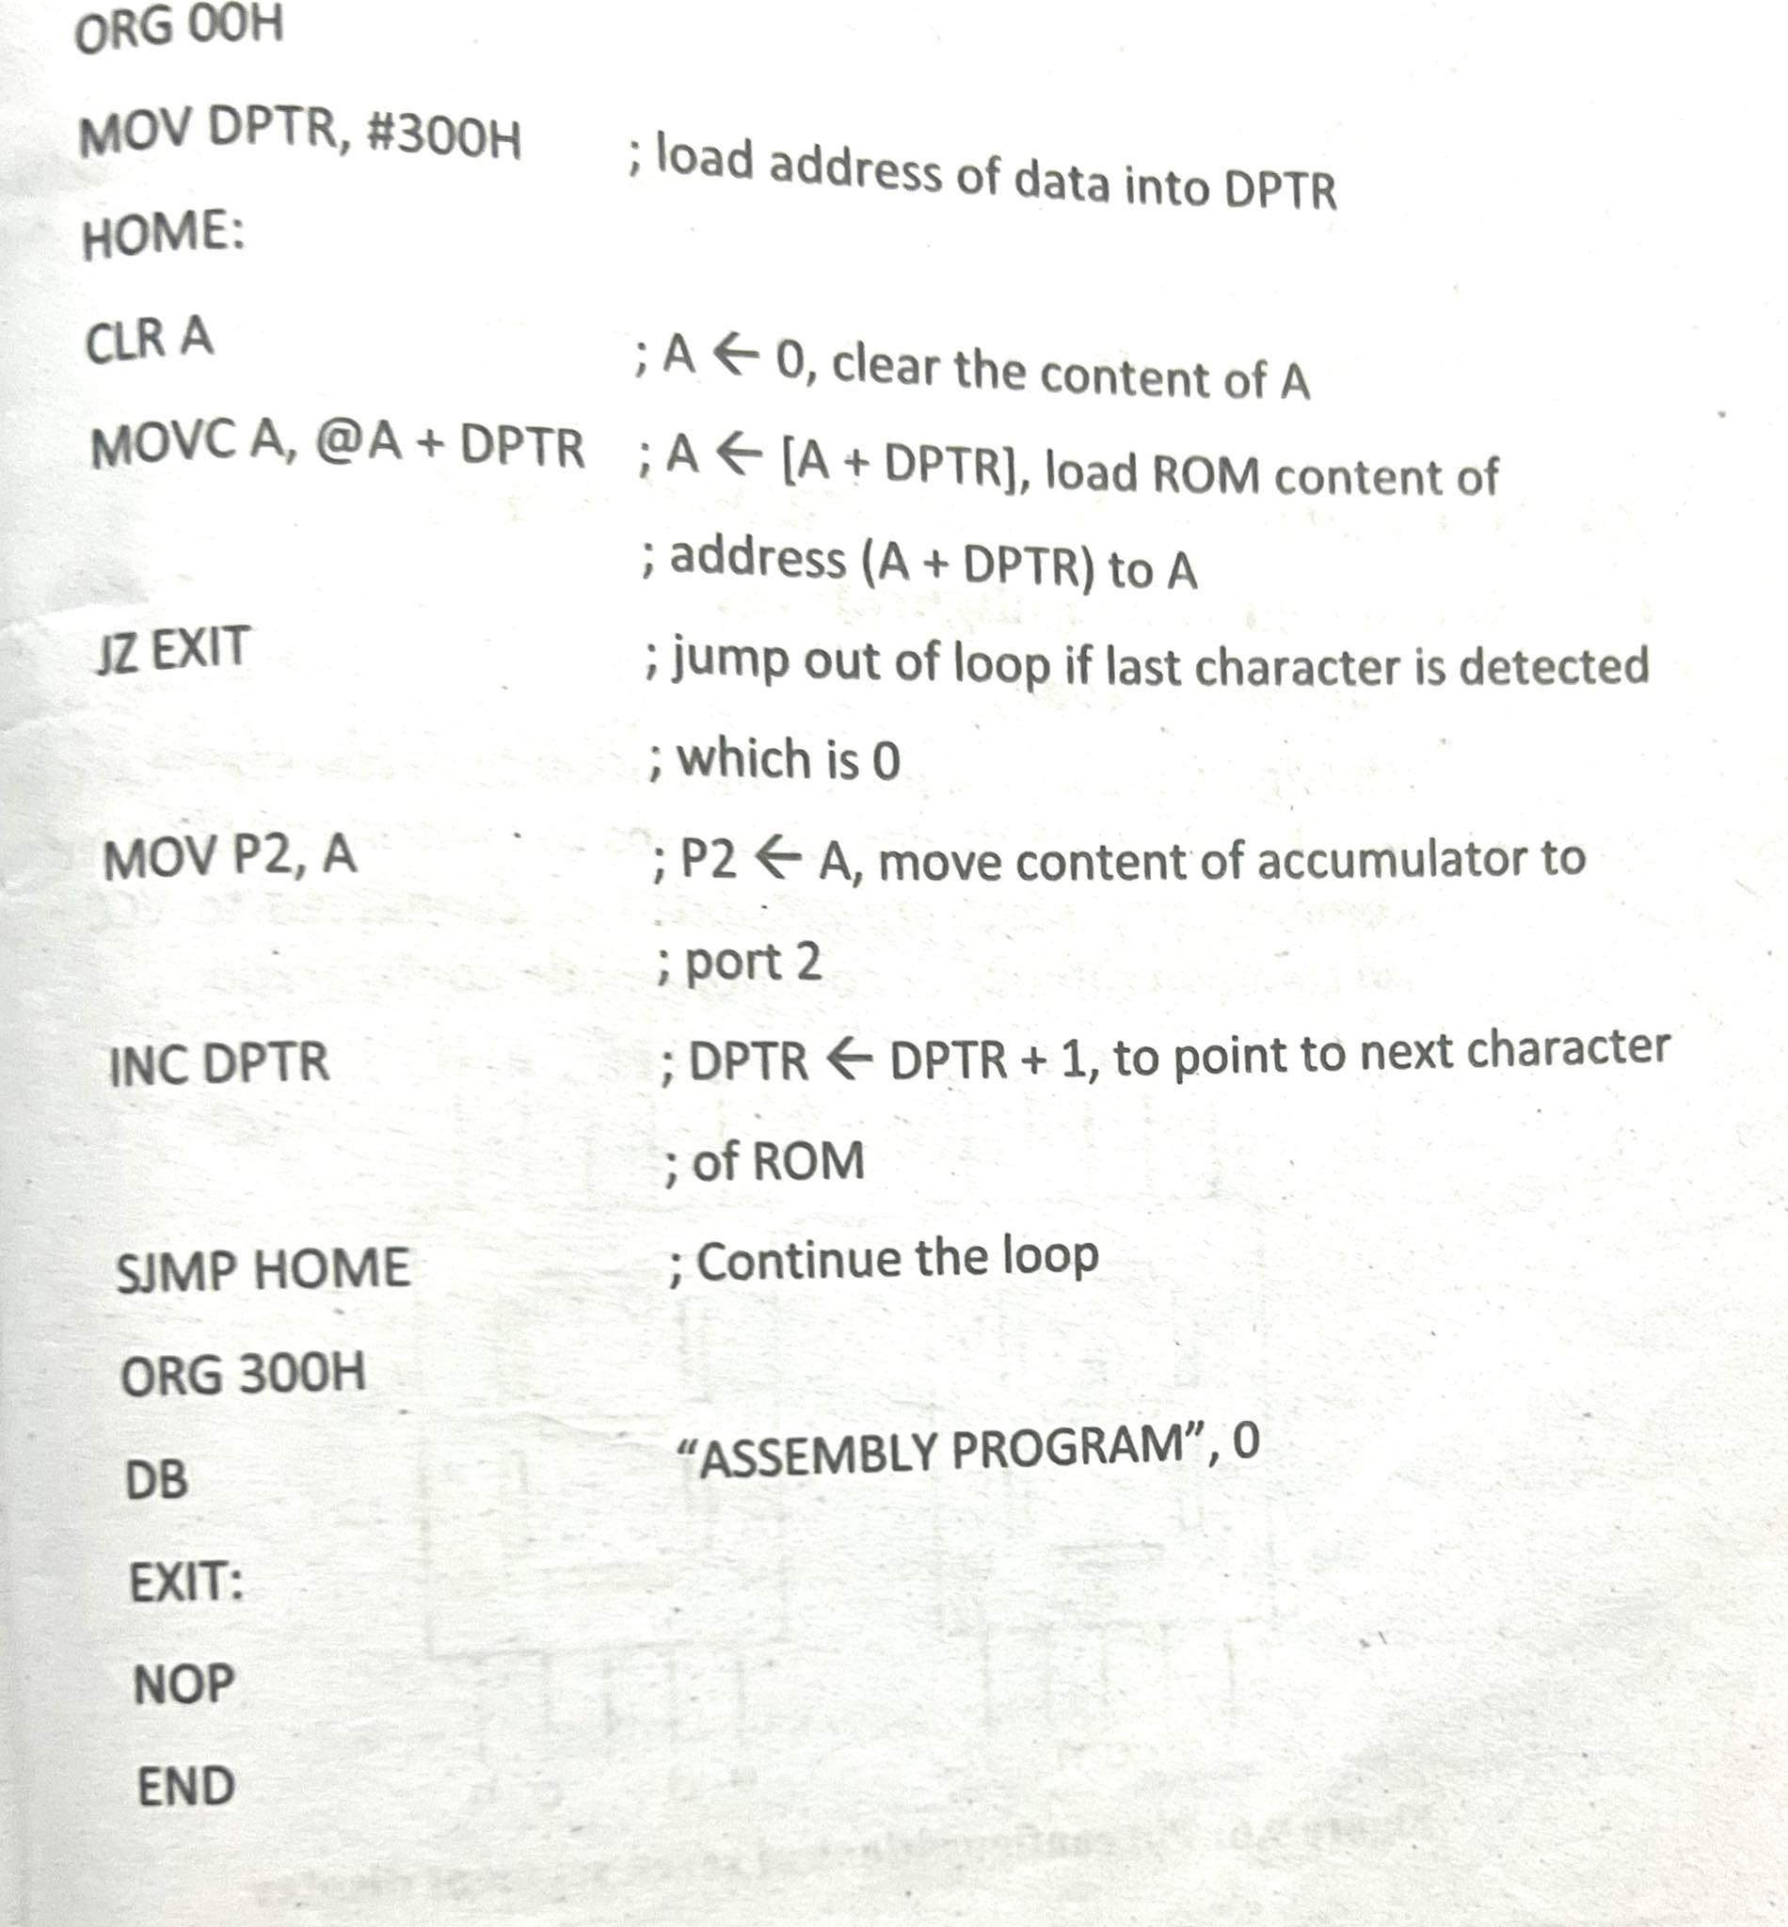
Q) ASCII character string is stored in the program memory starting at 300H. Send each character to port2

Slide 97
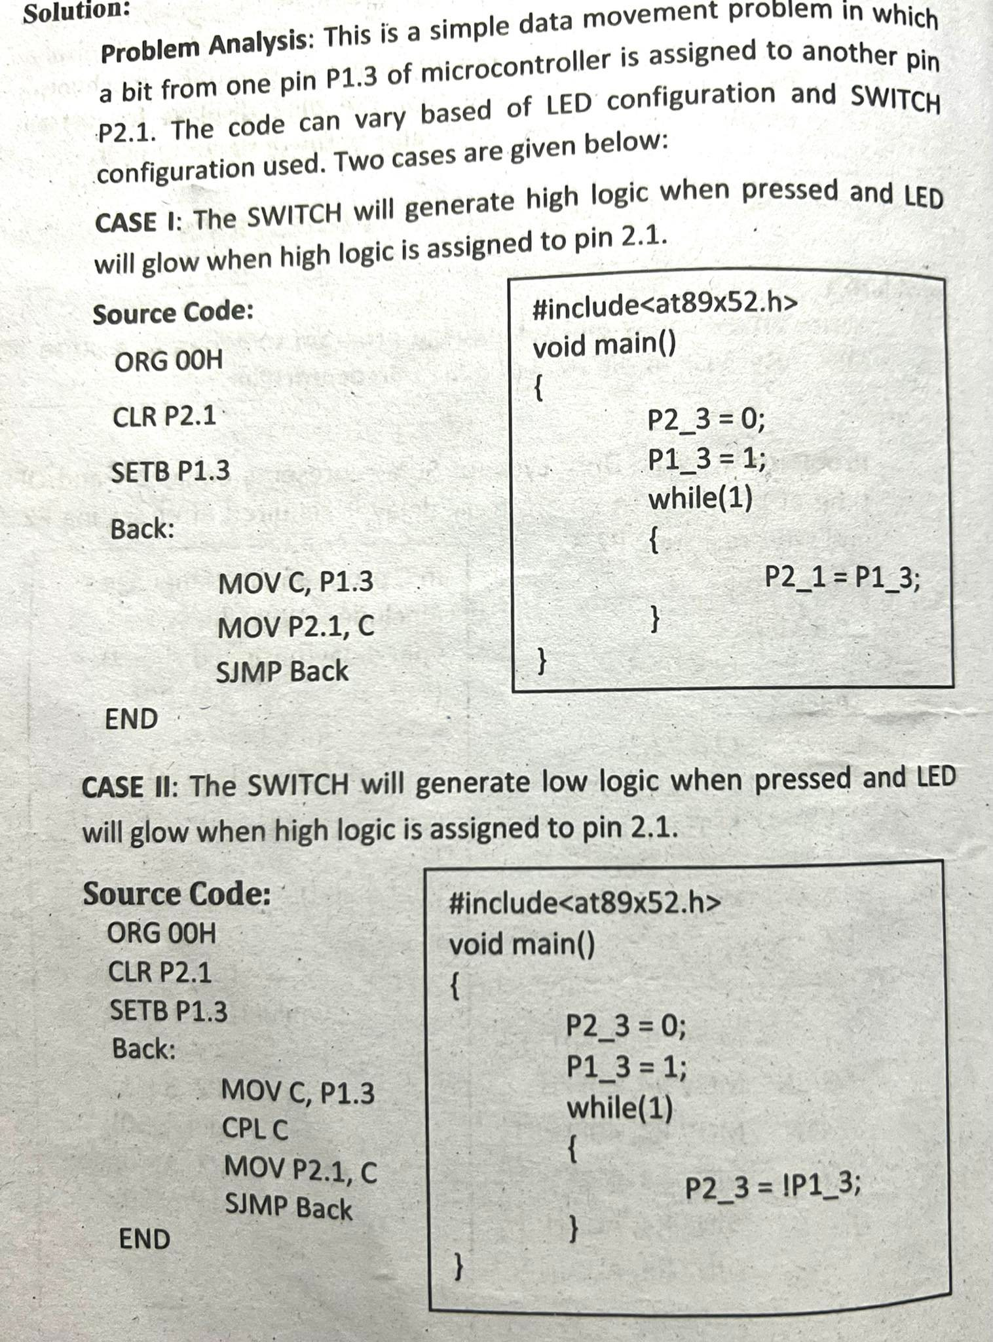
Q) Control the LED connected at 2.1 by a SWITCH which is connected to P1.3. ON/OFF status of LED is defined by ON/OFF status of switch

Slide 98
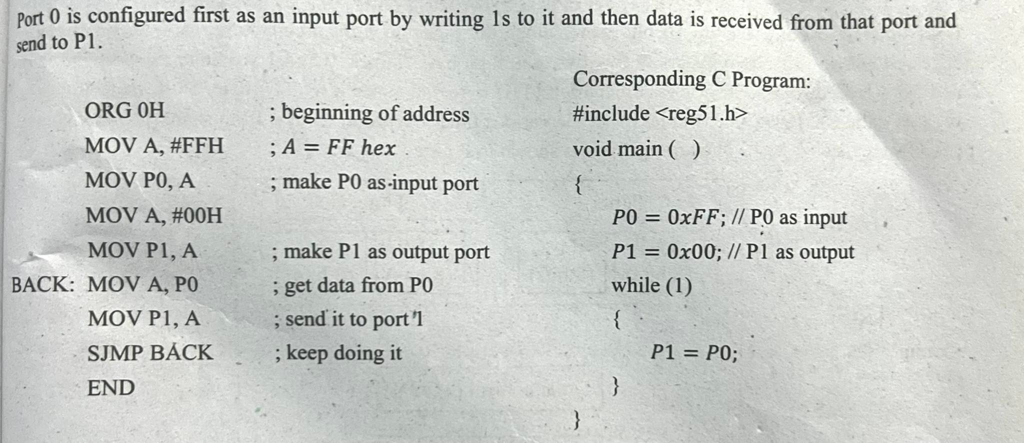
Q) Write an assembly language programming for 8051 microcontroller to read the data from switches connected to port 1 and send it to the port 2 for display in LED

Slide 99
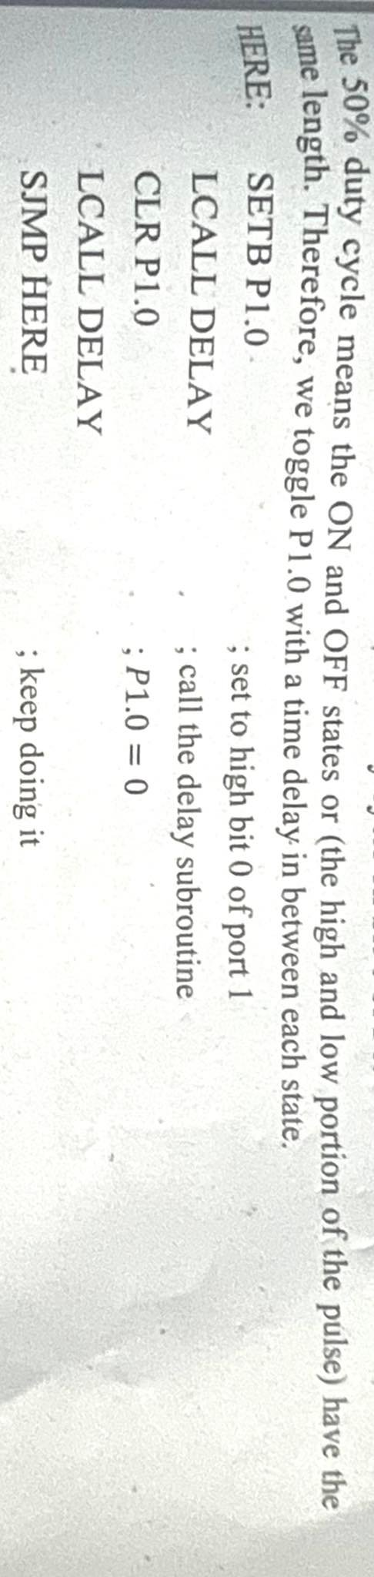
Q) Create a square wave of 50% duty cycle on bit 0 of P1

Slide 100
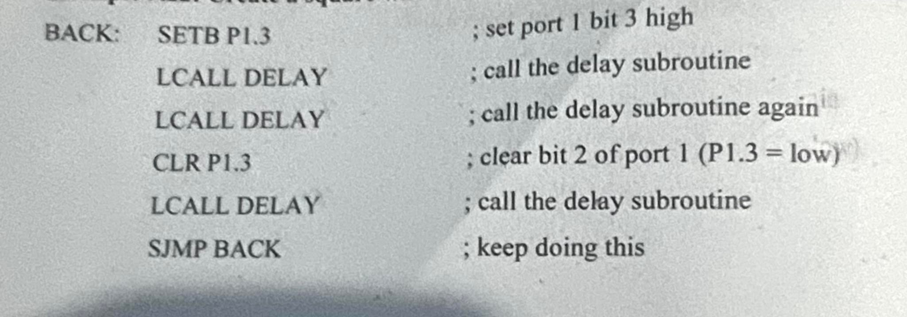
Q) Create a square wave of 66% duty cycle on bit 3 of Port 1

